Slide 1

Transportation ERP Module
TEAM-3
2410030245-vishnuchethana
2410030248-swathi
2410030249-Nikhila

Slide 2
Abstract
The Campus Transportation enhances the existing college ERP transportation module with a simple, fast, and user-friendly interface. The system provides an interactive bus seat map, route and pickup-point visualization, QR-based digital bus pass, transportation fee details, and transportation history. The proposed system reduces confusion caused by traditional forms and large tables while making transportation information easier to access. The design focuses on accessibility, responsiveness, performance, and ease of use for students and transport administrators

Slide 3
Problem Statement :
The existing ERP relies on traditional forms and tables, making seat allocation, routes, pickup points, fees, and transportation details difficult to understand and access.
Its wide tables, multiple navigation steps, lack of a QR bus pass, and limited mobile responsiveness reduce usability and performance.

Slide 4
Introduction
Modernizes the existing College ERP Transportation Module.
Provides a simple and user-friendly transportation interface.
Enables interactive bus seat selection and visualization.
Displays routes and pickup points clearly.
Provides a QR-based digital bus pass.
Shows transportation fee details and history.
Ensures responsive, accessible, and high-performance usage.
Helps students and transport administrators manage transportation efficiently.

Slide 5
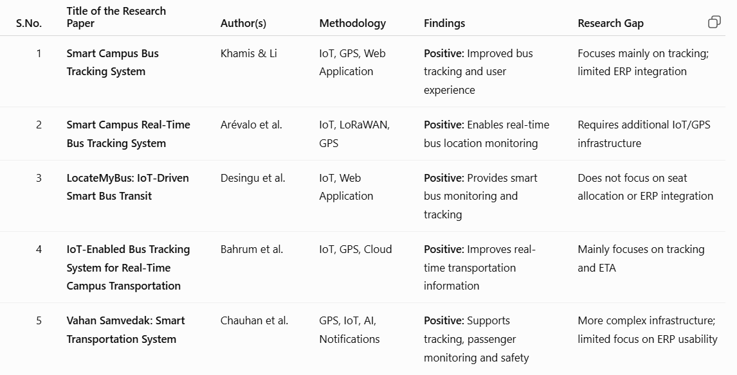
Literature survey

Slide 6
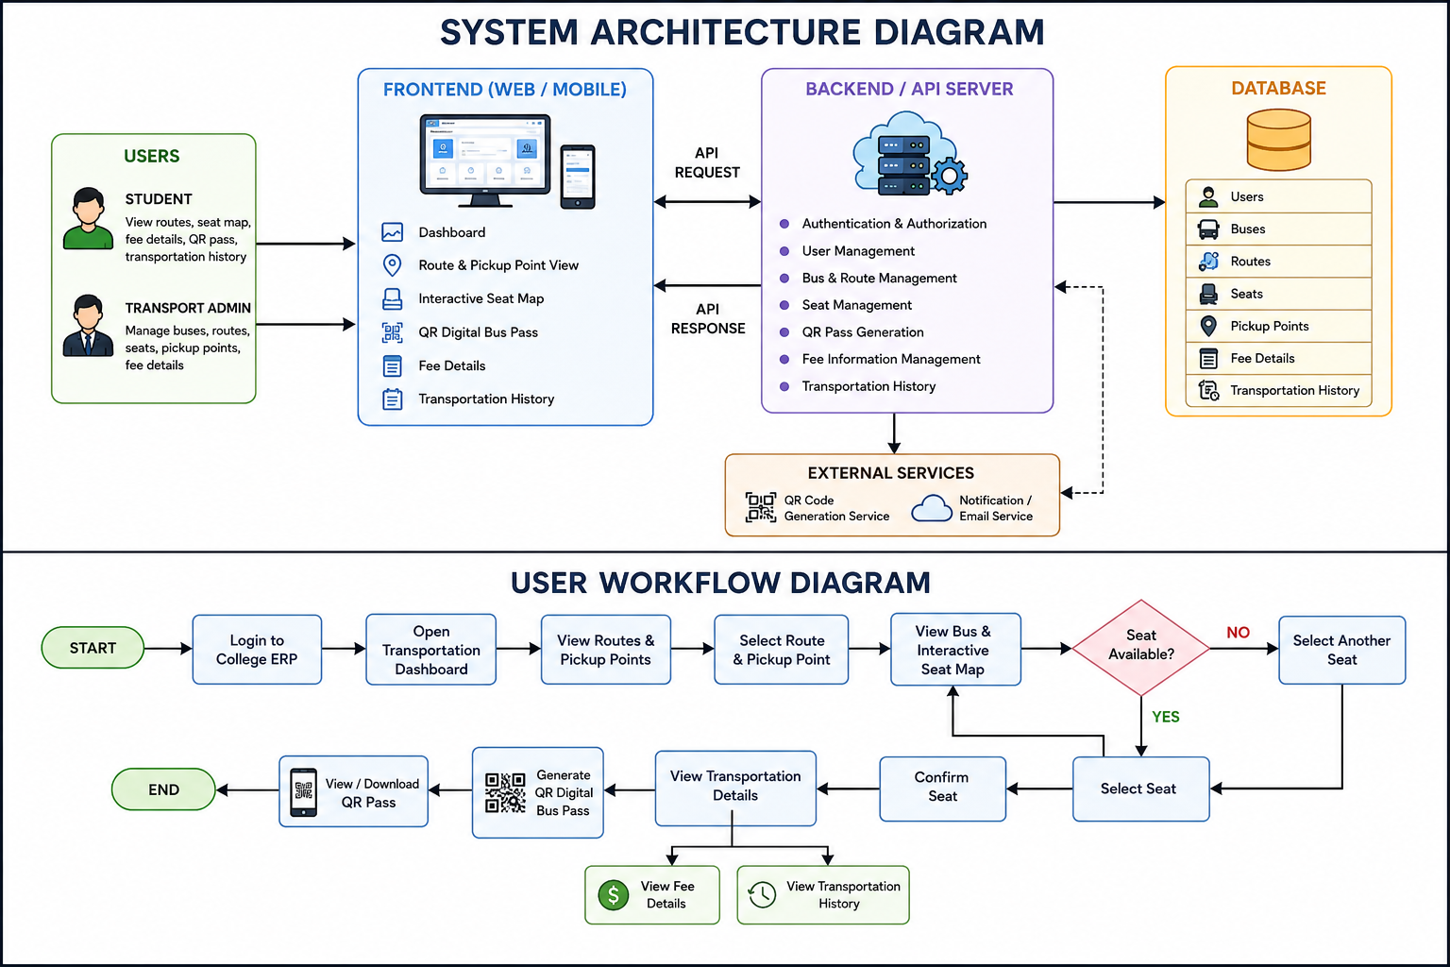

Slide 8
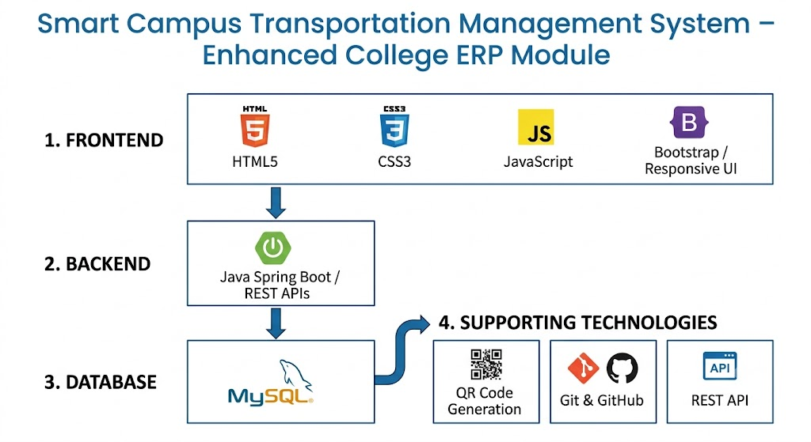
Technology Stack

Slide 9
Thank you

